Slide 1

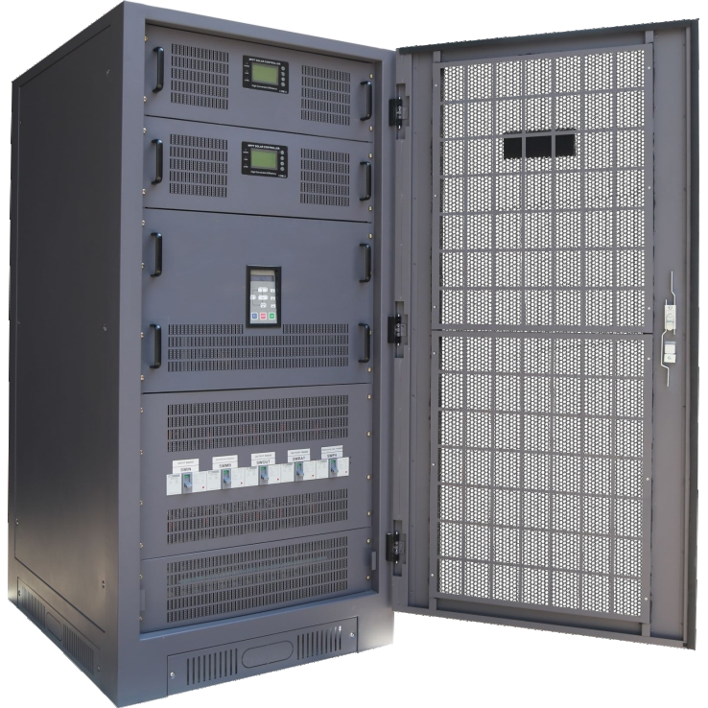
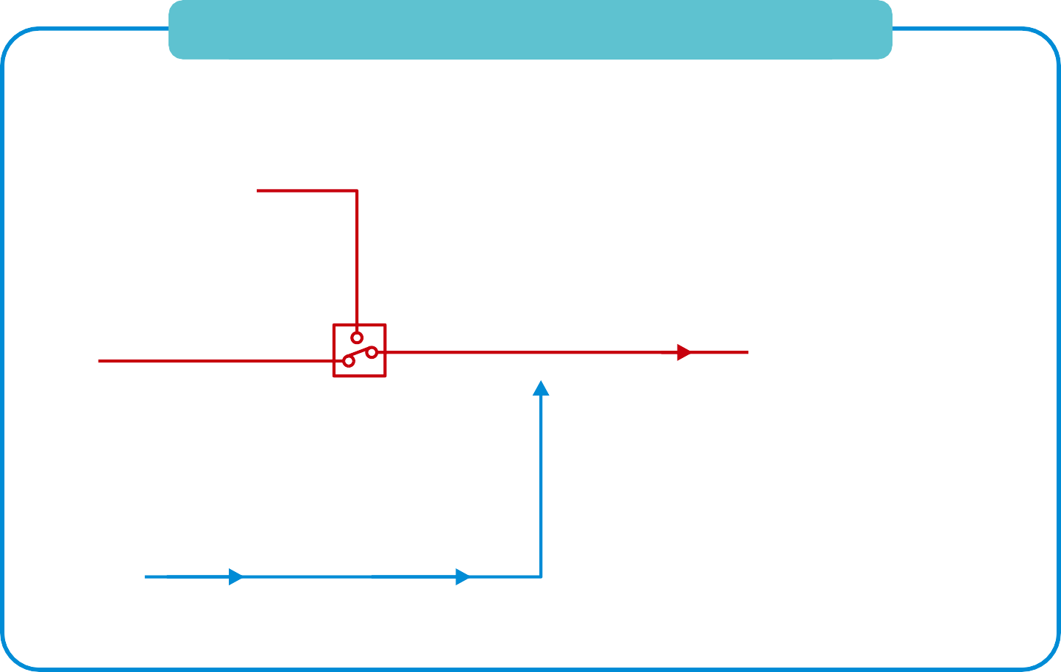
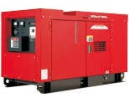
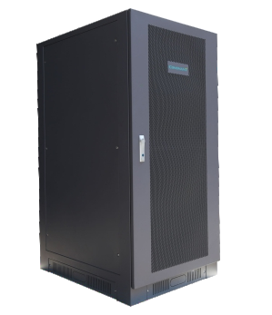






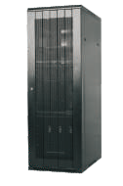

CNS115 series
Single Phase Off Grid Inverter
Single phase inverter Technology with output tranformer
Include PWM with MPPT charge controller
Provide uninterruptible backup power to load when utility grid line is not available
High effciency >90%
Generator connected signal and automatic start generator signal when generator as other energy source of the system
Transfer time 4-10ms Inverter to utility
Special design for using at high grid ﬂuctuation area
ISO9001 and ISO14001 certiﬁed factory
SINGLE PHASE OFF GRID INVERTER
AC Generator
OFF GRID INVERTER
AC load
AC
AC
Factory
Hospital
ATS
Grid Line
School
Hotel
Solar Controller
DC
DC
Battery Bank 240Vdc 20Pcs
PV array

Slide 2

TECHNICAL PARAMETER
Model |  | CNS115-10 | CNS115-15 | CNS115-20 | CNS115-25 | CNS115-30 | CNS115-40 | CNS115-50
INVERTER | Power | 10kw | 15kw | 20kw | 25kw | 30kw | 40kw | 50kw
 | Battery Storage | 100-200Ah | 150-300Ah | 200-400Ah | 250-500Ah | 300-600Ah | 350-750Ah | 450-900Ah
 | PV System | 10-12kwp | 15-17kwp | 20-25kwp | 25-30kwp | 30-35kwp | 35-40kwp | 45-50kwp
 | Generator | 10kw | 15kw | 20kw | 25kw | 30kw | 40kw | 50kw
 | Electrical Grid | 10kw/45A | 15kw/68A | 20kw/90A | 25kw/115A | 30kw/136A | 40kw/160A | 50kw/227A
MPPT Solar Controller | 240VDC | 50A | 70A | 100A | 100A | 150A | 180A | 200A
BATTERY VOLTAGE | Normal Voltage | 240 Vdc
 | Voltage Range | 210-290 Vdc
 | Max.AC Charging Current | 40A | 60A | 75A | 90A | 112A | 130A | 200A
 | Maximum Battery current | 42A | 63A | 85A | 105A | 125A | 145A | 210A
AC CHARGE | Voltage Charge | 250-290 Vdc
 | Charging Current(Max.) | 20Adc | 30Adc | 40Adc | 50Adc | 60Adc | 75Adc | 100Adc
AC INPUT GRID LINE GENERATOR | Generator Power | 10kw | 15kw | 20kw | none | none | none | none
 | Voltage | L-N:220/230/240Vac +/-10%
 | Phase | 1Phase 2Wire + PE
 | Frequency | 50/60 Hz ± 3%
 | Function start/stop | Relay dry contact 10A(ACC on and start)
 | Power Continuous(PF=1) | 10kw | 15kw | 20kw | 25kw | 30kw | 40kw | 50kw
AC OUTPUT | Output Voltage | L-N:220/230/240Vac 1Phase 2Wire + PE
 | Voltage Regulation | +/-5% steady load.<4% step load within 0.1sec
 | Frequency | 50/60 Hz ±0.1%
 | Total Harmonic Distortion | THD<3% (linear load)
 | Wave Form | Pure sine wave
 | Overload Capability | >125% load for 10 min,150% load for 30sec,>150% load for 10sec,200% load at 2sec
ISOLATION | Type | Galvanic isolation
EFFICIENCY | Ivnerter Peak(Max.) | >90%
PROTECTION | System | Over current, Overload,Over temperature,Short circuit,Over voltage,Under voltage,Low battery and Over battery voltage
 | IP level | IP20
ALARM | Operation Alarm | Low battery,Overload,Over temperature and Fault
COOLING | System Operate | Temperature control
ENVIRONMENT | Tenmperature | 0-45℃
 | Relative Humidity | 0-95%(Non-condensing)
DESIGN REGULATION PHYSICAL | Tested According to | AS/NZ 3100,EN61000-6-1/-3,EN50178 and IEC 62040
 | Dimension WxDxH(mm.) | 800*1030*1655 （with built-in MPPT)
 | Weight(kg) | 200 | 250 | 250 | 250 | 300 | 550 | 600
Remark:
The voltage is avaiable to L1-N 120VAC, L2-N 120VAC, L1-L2 240VAC

Slide 3



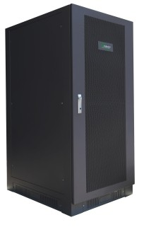

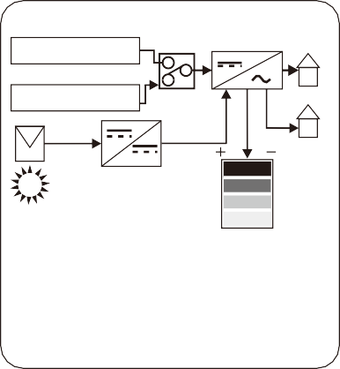
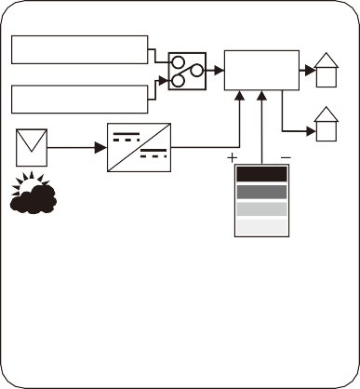
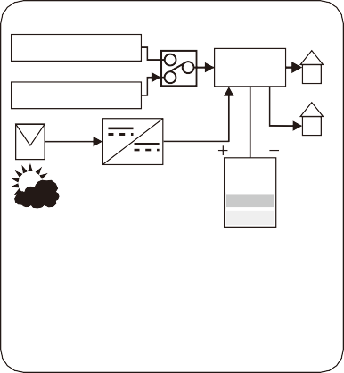
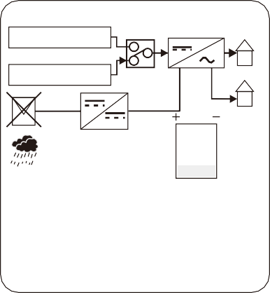
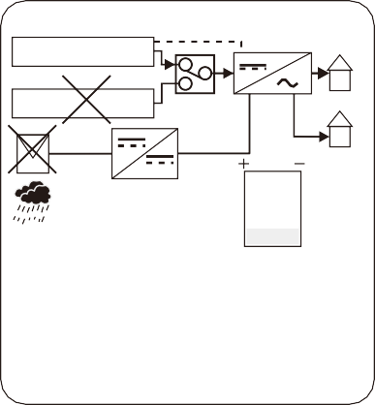
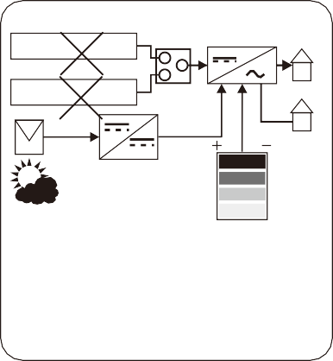
Infromation Communication Technology
GSM network monitoring system solution
Ethernet wired monitoring system solution
User GSM network
WiFi
GPRS
User wired network
WiFi
GPRS
WiFi Router
Internet
WiFi
WiFi Router
Internet
WiFi
WiFi
WiFi
ENET Server
WiFi
Modem GSM
WiFi Router
WiFi Router
Ethernet
CNS115 series Off Grid Inverter
GSM
Network
GSM
Modem
Internet
GSM
Modem
WiFi wireless monitoring system solution
User wireless network
WiFi
GPRS
LAN
Internet
WiFi Router
WiFi
Rs485
LAN
WiFi
HMI
WiFi
WiFi Router
WiFi Server
WiFi
WiFi
Operation Mode
GENERATOR
Inverter
Backup Load
GENERATOR
Inverter
Backup Load
GENERATOR
Inverter
Backup Load
UTILITY
ATS
UTILITY
ATS
UTILITY
ATS
MPPT
No Backup Load
MPPT
No Backup Load
MPPT
No Backup Load
Battery Unit
Battery Unit
Battery Unit
Sunny day PV energy large and Utitity grid normal.
Cloudy day PV energy small,
and Battery full Utitity grid normal .
Cloudy day PV energy small,
Battery medium and Utitity grid normal.
GENERATOR
Inverter
Backup Load
GENERATOR
Start
Inverter
Backup Load
GENERATOR
Inverter
Backup Load
UTILITY
ATS
UTILITY
ATS
UTILITY
ATS
MPPT
No Backup Load
MPPT
No Backup Load
MPPT
No Backup Load
Battery Unit
Battery Unit
Battery Unit
Rainy day No PV energy,Battery lower and Utitity grid normal.
Rainy day No PV energy,Battery lower, Utitity fails and Generator running.
Cloudy day PV small .Battery full,Utility and Generator fail

